Slide 1

Entering Scores
&
Pitch Counts
Start by logging in at
www.troybaseballboosters.com

Slide 2
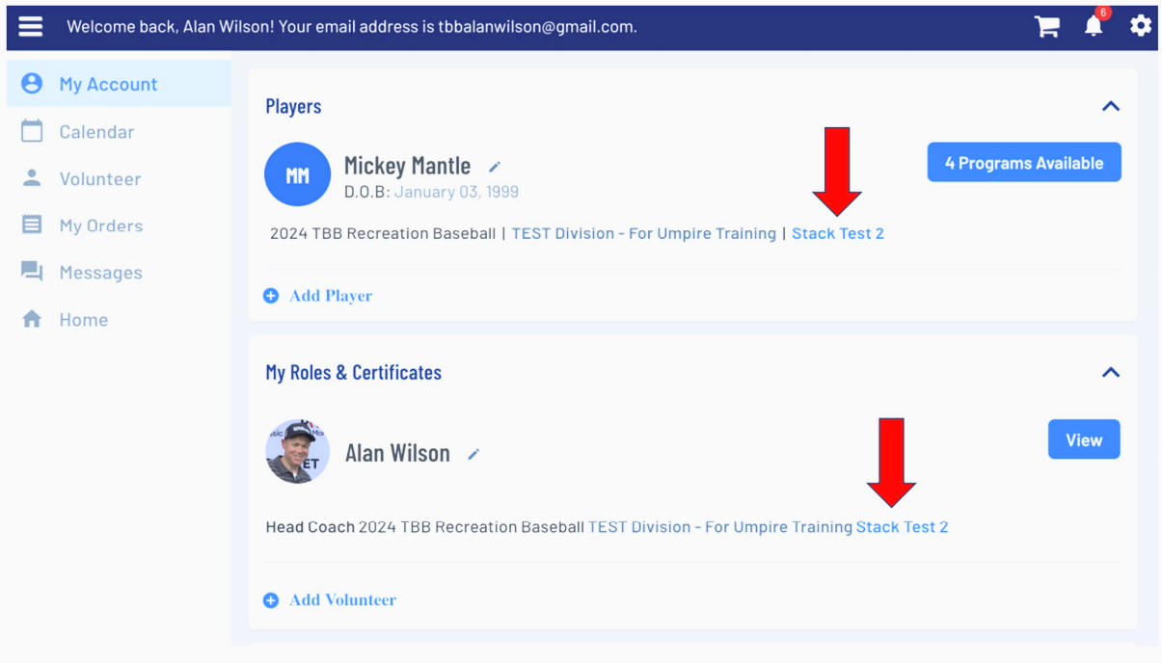
Entering Game Scores
Home Team Manager responsibility
Navigate to your Team Page
There are multiple ways to get there
NOTE: the Away Team Manager can not enter scores or pitch counts – system control

Slide 3
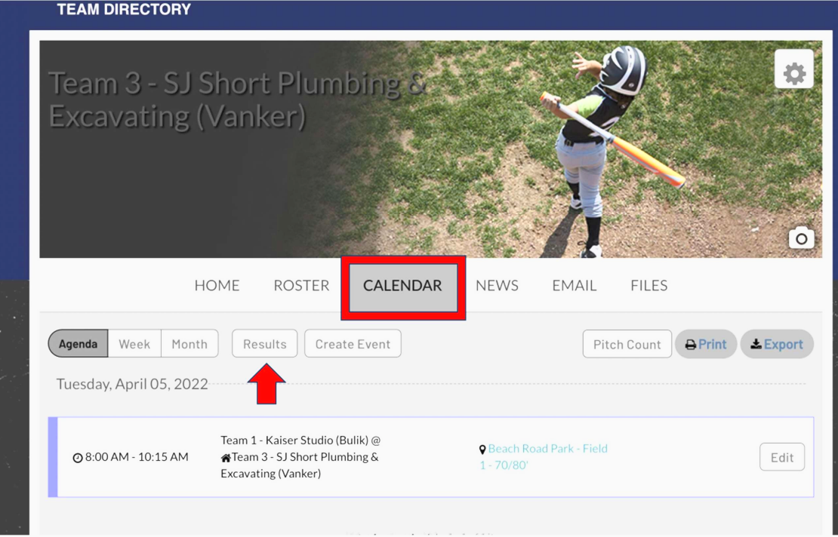
Entering Game Scores
Go to the Calendar
Select Results
REMINDER: please post game results within 24 hours after the game ends. This is especially important in “player pitch” leagues

Slide 4
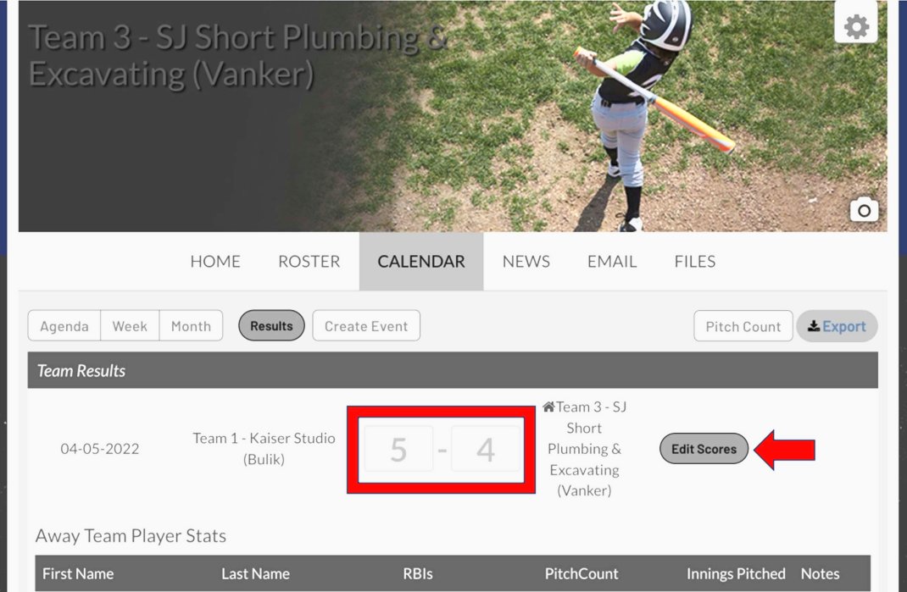
Entering Game Scores & Pitch Counts
Select Edit Scores
Enter each team’s score
New for 2026: scroll down and record the pitch count for each player that pitched for each team

Slide 5
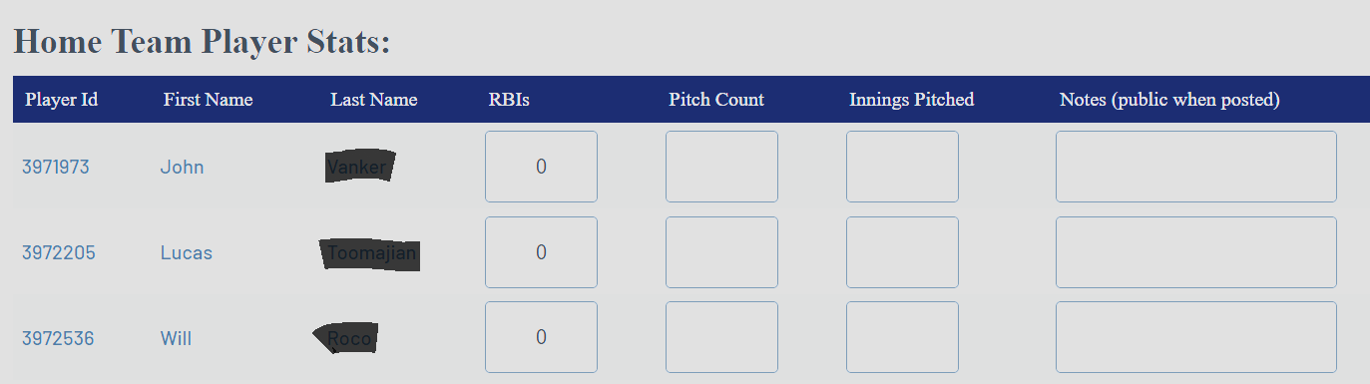
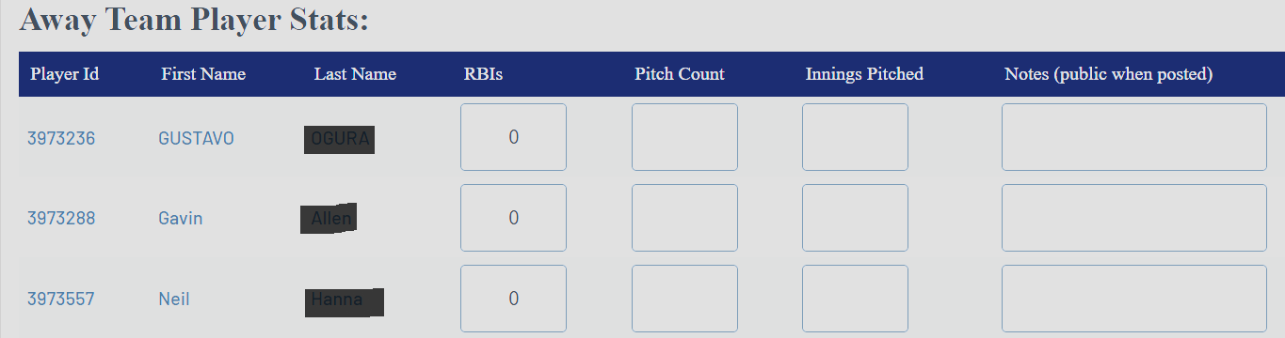

Entering Pitch Counts by Player
Enter the number of pitches thrown by every player that pitched for each team
Do not enter other stats
Scroll to the bottom of the page and “Save” when done

Slide 6
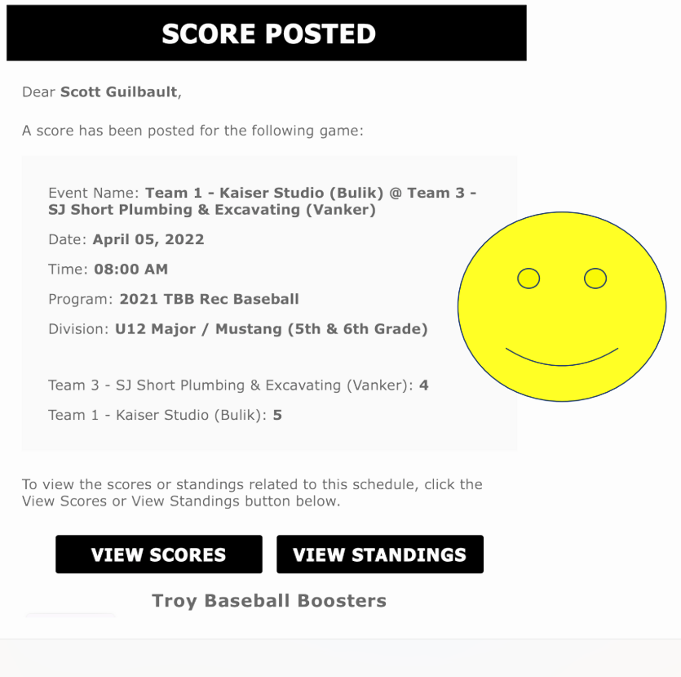
Email Confirming the Results
If you’ve entered the information correctly and Saved, the system will send an email showing the results
Contact for questions: mike.bryson@troybaseballboosters.com
Thank you!

